Slide 1


CITS1003 Introduction to Cybersecurity [2] Introduction
Dr David Glance

Slide 2
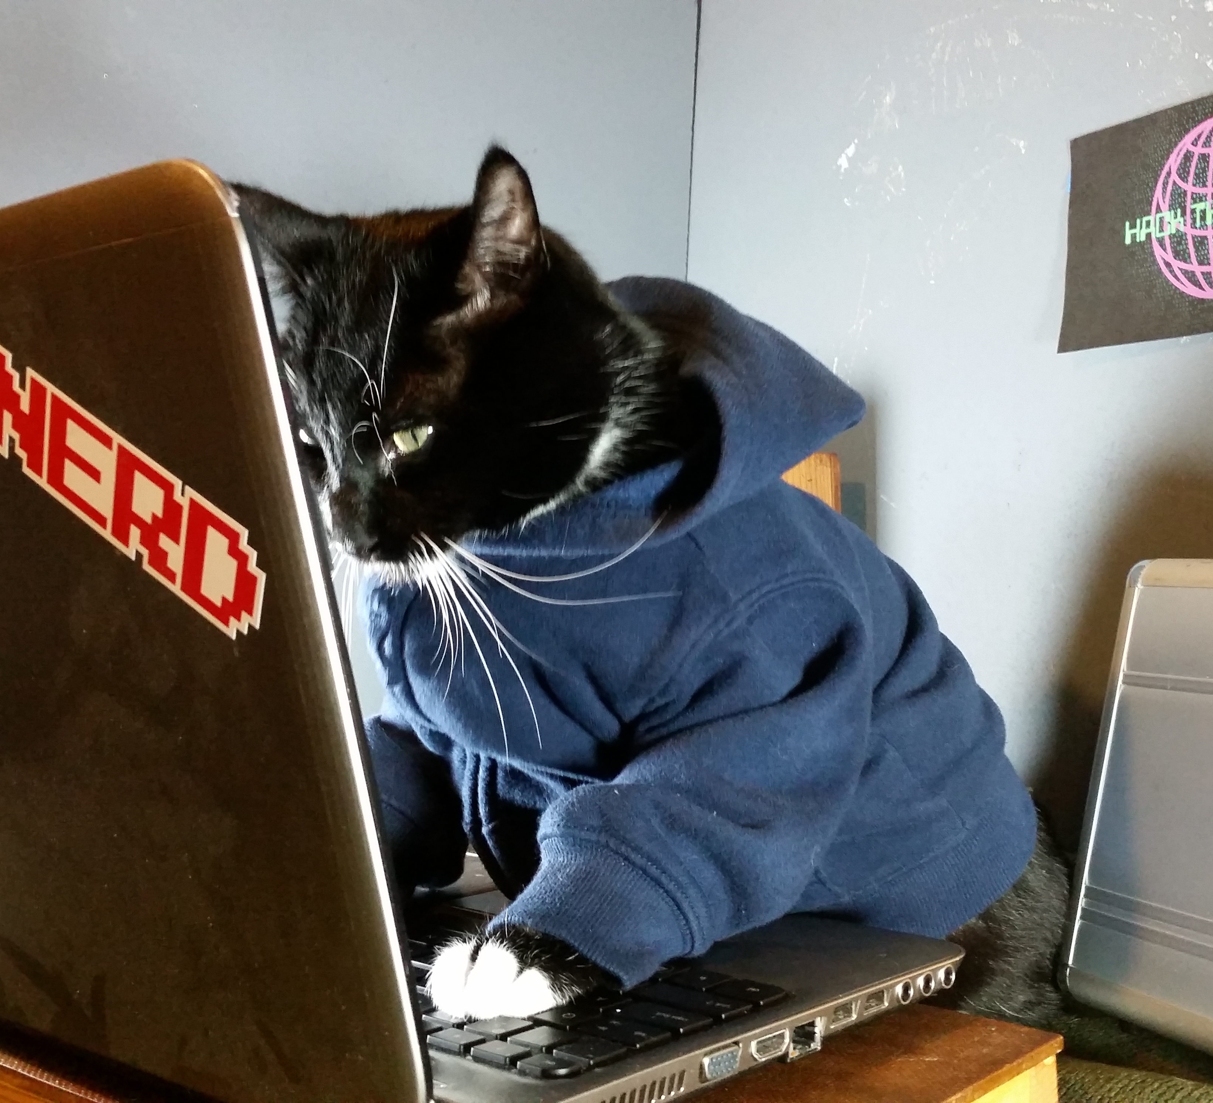
A unit about cats cybersecurity
https://imgur.com/gallery/7ok4g/comment/907261971

Slide 3

3 Things
An understanding of what Cybersecurity is
The terms used in Cybersecurity
That Security = Confidentiality + Integrity + Availability

Slide 4
Information Security
All human endeavour relies on information
Business, Government, Education, Research, Personal life
Information security is about protecting this information from “unauthorised access, harm or misuse”¹
This is done by preserving Confidentiality, Integrity and Availability of information (so-called CIA triad)

Slide 5
Cybersecurity
Cybersecurity is a subset of Information Security that concerns the digital realm – so:
Cybersecurity refers to the protection of information systems (hardware, software and associated infrastructure), the data on them, and the services they provide, from unauthorised access, harm or misuse. This includes harm caused intentionally by the operator of the system, or accidentally, as a result of failing to follow security procedures.¹
CIA is sometimes extended to include Authentication, Authorisation, Accountability, Non-Repudiation and Reliability
Privacy is part of confidentiality but is also independent. It is possible to infringe privacy without breaking confidentiality

Slide 6
Terms
Everyone has different understanding of the exact definition of cybersecurity terms depending on their perspective: Consumer, IT, Risk Management, Business, Government, Military, Policy Makers
In part because the calculation of financial loss from an incident is partly subjective e.g. intellectual property theft, customer passwords
Important to calculate risk properly otherwise it is very hard to know how much money and time to invest in controlling that risk.

Slide 7
Terms: Asset, Vulnerability, Threat
Asset: Anything of value to an organisation whose loss, or degradation of function would cause the organisation economic loss.
Files, processes, programs, databases,
Disks, Servers, Mobile phones, laptops
Personnel, property
Vulnerability: weakness in an organisation’s assets that when exploited will lead to economic loss
Threat: anything that can exploit a vulnerability in a way that leads to a negative impact

Slide 8
Terms: Risk, Threat Actors, Threat Actions
Risk: Is the probable frequency and probable magnitude of future loss from a threat acting on a vulnerability.
Threat Actor: Person, group or external force responsible for threats.
Can be internal and external.
External actors can be environmental: earthquakes, fire, flood, wind, etc.
Internal actors may have motivation that is malicious or simply error
Threat Action: What the threat actor did or caused e.g. malware, hacking, social, etc
Control: measures that mitigate a risk. Can be:

Slide 9
Terms: Controls
Control: measures that contain or minimize a cybersecurity risk. Can be:
Preventive
Detective
Corrective
Also known as a safeguard, security control, countermeasure, mitigation

Slide 10
Terms: Risk Responses
Once a risk has been identified, it can be:
Reduced or mitigated
Assigned or transferred
Accepted
Deterred
Avoided
Rejected or ignored

Slide 11
Terms: Subjects and Objects
A subject is an entity such as a person, software process, computer, device that can access an object
An object is an entity that provides information to a subject. Examples of objects are files, databases, programs, storage media, processes

Slide 12
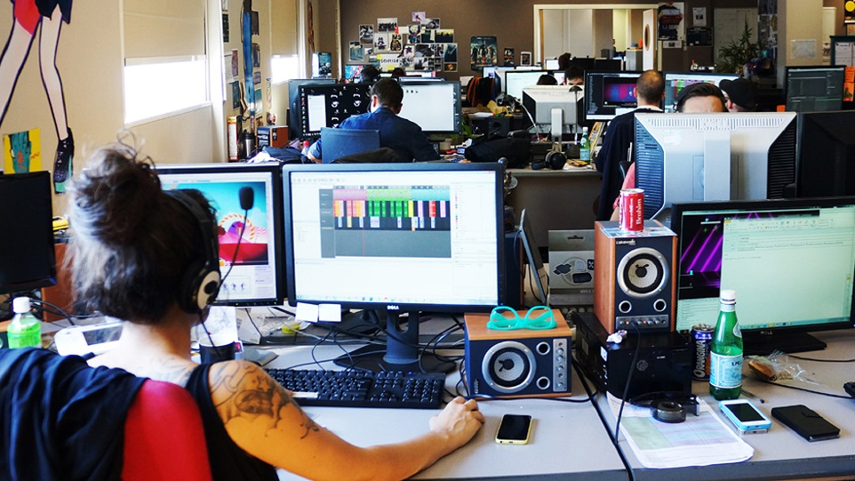
Scenario
Games company
Developing new product
Dealing with suppliers, distributors, customers
Other employees not on the team
Hackers: CD Projekt Cyberpunk 2077, Witcher 3

Slide 13
Confidentiality
The property of information security that information is not made available or disclosed to unauthorised individuals, entities, or processes.
What information is deemed confidential is subjective (other than Personally Identifiable Information PII) and arises out of an agreement between parties
May be any information relating to the company (Apple) that staff are obliged not to disclose
Specific disclosures to staff and customers covered by Non-Disclosure Agreements (NDA)
Information relating to national security
May also be information that a consumer wants protecting e.g. credit card transactions

Slide 14
Confidentiality, Privacy and Data Protection
Privacy is the right to keep information about yourself, confidential
This includes what you do, when you do it, who you do it with, where you do it
Australia has Privacy Act 1988 – operates on ”privacy principles”
States have their own legislation – WA has:
Freedom of Information Act 1992
State Records Act 2000
Surveillance Devices Act 1998

Slide 15
Keeping things confidential
Information classification: For example: unclassified, secret, top secret
Access controls: who or what gets to read, write, update, delete, execute
Encryption: encrypting information at rest and in transit
Information management: classification, life cycle
Governance: oversight of how the organisation manages data lifecycle

Slide 16
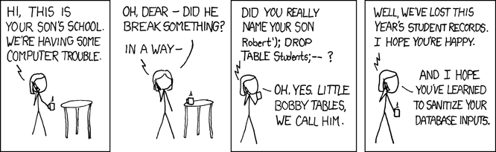
Integrity

Slide 17
Integrity
Protects the reliability and correctness of data
Prevents unauthorized alterations of data
Examples:
You deposit $200 into your account which holds $1,000 : you want to be certain that after the transaction, it holds $1,200
You have submitted a legal contract and you want to know that it will not be altered after it has been submitted
Protection against errors as well as deliberate changes
List of dependencies:
Accuracy, Truthfulness, Authenticity, Validity, Nonrepudiation, Accountability, Responsibility, Completeness, Comprehensiveness

Slide 18
Non-repudiation
Scenario:
John: I sent you an email to change the appointment that is why I wasn’t there
Joanna: No you didn’t
Stops a subject from claiming that an event or action did not occur
Essential part of accountability
Needs proof of identity
Usually implemented through digital signatures

Slide 19
Availability
Authorized subjects get timely and uninterrupted access to objects (the data and information they need)
Threats to availability include:
Device failures
Software errors
Environmental issues; Fire, Flood, Wind, Power loss)
Distributed Denial of Service (DDoS) attacks
Ransomware attacks
Mitigation: Fault tolerance, backups, disaster recovery sites, protections against attacks

Slide 20




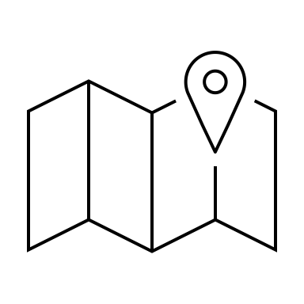
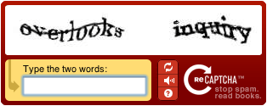
Identity and Authentication
beidou@pirates.liyue.com

Slide 21
Identity and Authentication
Identity is about being able to prove to a system that you are who you say you are
Authentication verifies the identity using authentication factors:
Passwords, Smartcards, Tokens, Biometrics
Can you multiple factors especially 2FA (Two Factor Authentication)
Factors sometimes defined as:
Type 1: Something you know
Type 2: Something you have
Type 3: Something you are or something you do
Somewhere you are
Context-Aware Authentication
Process of registration is important – proving your identity
Identity Management Systems manage accounts and implement authentication schemes

Slide 22
Authorization
Determines what actions a subject can carry out on an object
Actions may be context dependent
Computer systems most commonly:
Read, Write, eXecute
CRUD: Create, Read, Update/Insert, Delete
Series of other access control schemes:
Discretionary Access Control (DAC)
Mandatory Access Control (MAC)
Role-Based Access Control (RBAC)
Rule-Based Access Control
Attribute Based Access Control

Slide 23
Accountability
To be able to identify all relevant information regarding actions in a system
Relies on identity and authorisation
Implemented with monitoring and logging
In order to reduce the volume of logging information may use machine learning to detect anomalous behaviours
Carry out audits

Slide 24
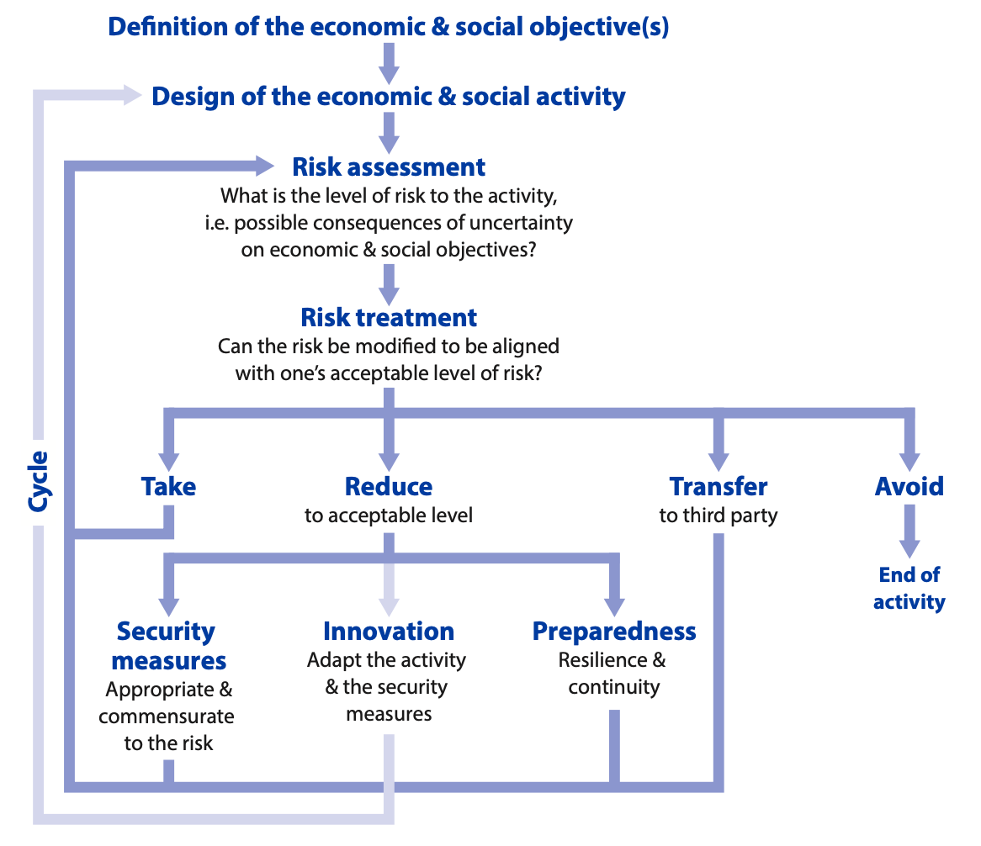
Risk Management
OECD recommendations for Digital Security Risk Management https://www.oecd.org/sti/ieconomy/digital-security-risk-management.htm
Importance of understanding economic and social activities of the business
Risk governance

Slide 25
Risk Analysis
Qualitative: Assess risk in terms of rating risk on a scale
Although simpler, it is not granular and so loses usefulness because of that
How do you know what High, Medium, Low or 3.5/5 means? How much will you lose if you have a loss? How much will you spend to control this risk?
Quantitative: Work out numbers for frequency of risk events based on detailed understanding of assets, threats and vulnerabilities
More complicated
Needs maturity and access to detailed organisational information
Need to understand:
Assets of organisation
Threat analysis
Vulnerability assessment

Slide 26
Quantitative Risk Assessment
Asset Valuation AV
Exposure Factor EF %
Single Loss Expectancy SLE = AV * EF
Annualized Rate of Occurrence ARO %
Annualized Loss Expectancy ALE
Cost/Benefit of countermeasures

Slide 27
Example
You own an iPhone 12 which costs AU $1,349. If you drop the phone and the screen breaks, the cost of repair is AU $850. You have dropped your phone on average once every 2 years
AV = $1,349
Exposure Factor = 0.63
Single Loss Expectancy = $850
Annualized Rate of Occurrence = 0.5
Annualized Loss Expectancy = 0.5 * 850 = $425
Apple Care+ costs $199 for 3 years and $45 per incident for screen replacement
Annualized cost of insurance = $67 + $45 * 0.5 if there is an incident = $92
$425 > $92 and so insurance is worth it

Slide 28
Threat Analysis and modeling
Threat models ask the following basic questions with reference to a system:
Who is the attacker
Why are they attacking
How are they attacking
Ultimately allows for calculation of risk for which there must be a vulnerability, a threat and some impact
Threat models need to be applied to systems as a whole, not just to specific parts of a machine learning pipeline in isolation
They need to be based on realistic scenarios with credible threat actors and credible goals and motivations

Slide 29
Threat models
PASTA: Process for Attack Simulation and Threat Analysis
STRIDE (Microsoft) Threats related to software: Spoofing, Tampering, Repudiation, Information Disclosure, Denial of Service, Elevation of Privilege
Attack Trees: Describe the steps needed for a threat to be actioned in a tree structure
Hybrid Threat Modeling Model: (SEI): Persona non Grata

Slide 30
Threat Analysis and modeling
Process of identifying threats
PASTA: Process for Attack Simulation and Threat Analysis
STRIDE (Microsoft) Threats related to software: Spoofing, Tampering, Repudiation, Information Disclosure, Denial of Service, Elevation of Privilege
Attack Trees: Describe the steps needed for a threat to be actioned in a tree structure
Hybrid Threat Modeling Model: (SEI): Persona non Grata

Slide 31
Vulnerability Assessment
Vulnerability: weakness in an organisation’s assets that when exploited by a threat will lead to economic loss
Vulnerability description ontology: https://csrc.nist.gov/publications/draft-pubs#NIST-IR-8138 (more detail later)
Can be found through 3rd party information:
US National Vulnerability Database
CVE (Common Vulnerability Exposures)
CERTs (Computer Emergency Readiness/Response Team)
VulnDB

Slide 32
Vulnerability Assessment II
Although a vulnerability may be identified in software say, whether it can be exploited will depend on the context of the system – so knowing vulnerabilities alone is not always enough
Identify vulnerabilities through:
Asset management: what software, versions and patch levels
Vulnerability scans
Penetration Tests
Enables prioritization of vulnerabilities through risk assessment

Slide 33
Controls
Controls are applied to mitigate cybersecurity risk
Types:
Physical
Technical
Administrative
Functions
Preventative
Detective
Corrective

Slide 34
Control Examples
 |  | Control Functions
 |  | Preventative | Detective | Corrective
Control Types | Physical | Fences, gates, locks | CCTV and surveillance camera logs | Repair physical damage, re-issue access cards
 | Technical | Firewall, IPS, MFA, AV | IDS, Honeypots | Patching, Reboot systems, Quarantine malware
 | Administrative | Hiring and Firing practices, Separation of Duties, Data Classification | Review access rights, audit logs, review unauthorised changes | Implement Business Continuity Plan, Incident response plan

Slide 35
Standards
ISO/IEC 27K series standards relating to Information Security Management:
ISO/IEC 27001 Information technology - Security Techniques - Information security management systems — Requirements
ISO/IEC 27002 Code of practice for information security controls
ISO/IEC 27005 Information security risk management
Other standards that focus on controls:
NIST SP800-53 Security and Privacy Controls for Information Systems and Organisations
https://csrc.nist.gov/publications/detail/sp/800-53/rev-5/final
Australian Cyber Security Centre Essential Eight https://www.cyber.gov.au/acsc/view-all-content/essential-eight
Good article on why the Essential Eight are not essential for the Australian Government https://www.zdnet.com/article/asd-essential-eight-cybersecurity-controls-not-essential-canberra/

